Slide 1

UNIVERSITY INSTITUTEOF ENGINEERING
Bachelor of Engineering (Computer Science & Engineering)
Operating System (20CST/ITT-313)
Subject Coordinator: Er. Puneet kaur(E6913)
Introduction to Operating System
DISCOVER . LEARN . EMPOWER
Font size 24

Slide 2
System Protection and Security
.

Slide 3
Goals of Protection
In a protection model, computer consists of a collection of objects, hardware or software
Each object has a unique name and can be accessed through a well-defined set of operations
Protection problem - ensure that each object is accessed correctly and only by those processes that are allowed to do so

Slide 4
Principles of Protection
Guiding Principle – Principle of Least Privilege
Programs, users and systems should be given just enough privileges to perform their tasks
Privilege Limits are damaged if entity has a bug.
Privilege Can be static (during life of system, during life of process)
Privilege Can be dynamic (changed by process as needed) – domain switching, privilege escalation
Must consider “grain” aspect
Rough-grained privilege management is easier, simpler, but least privilege is better
Fine-grained management is more complex, more overhead, but more protective
Domain can be user, process, procedure

Slide 5
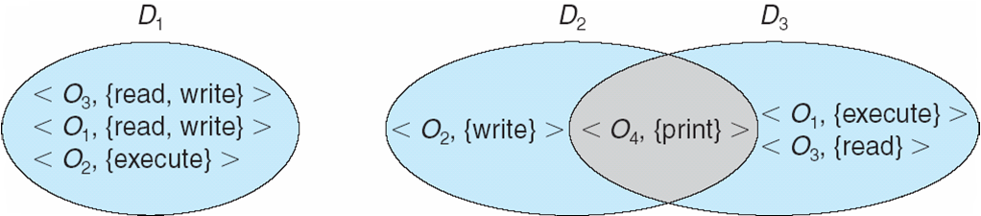
Domain Structure
Access-right = <object-name, rights-set>
where rights-set is a subset of all valid operations that can be performed on the object
Domain = Set of access-rights

Slide 6
Access Matrix
View protection as a matrix (access matrix)
Rows represent domains
Columns represent objects
Access(i, j) is the set of operations that a process executing in Domain_{i} can invoke on Object_{j}

Slide 7
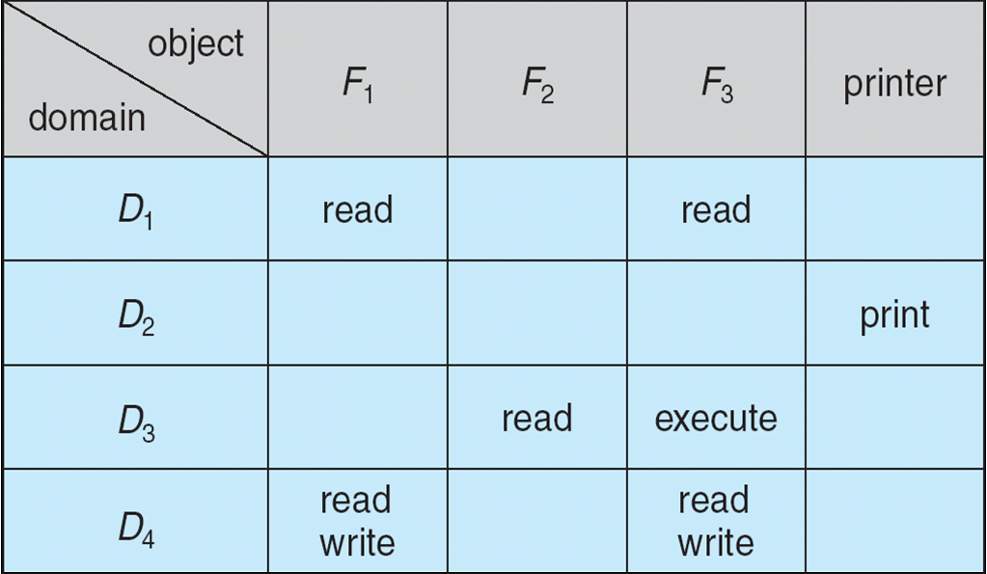
Access Matrix

Slide 8
Use of Access Matrix
If a process in Domain D_{i} tries to do “op” on object O_{j}, then “op” must be in the access matrix
User who creates object can define access column for that object
Can be expanded to dynamic protection
Operations to add, delete access rights
Special access rights:
owner of O_{i}
copy op from O_{i} to O_{j} (denoted by “*”)
control – D_{i} can modify D_{j} access rights
transfer – switch from domain D_{i} to D_{j}
Copy and Owner applicable to an object
Control applicable to domain object

Slide 9
Use of Access Matrix (Cont.)
Access matrix design separates mechanism from policy
Mechanism
Operating system provides access-matrix + rules
It ensures that the matrix is only manipulated by authorized agents and the rules are strictly enforced
Policy
User dictates policy
Who can access what object and in what mode
But doesn’t solve the general confinement problem

Slide 10
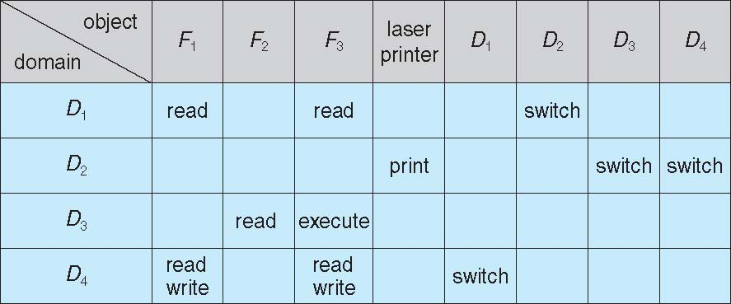
Access Matrix with Domains as Objects

Slide 11
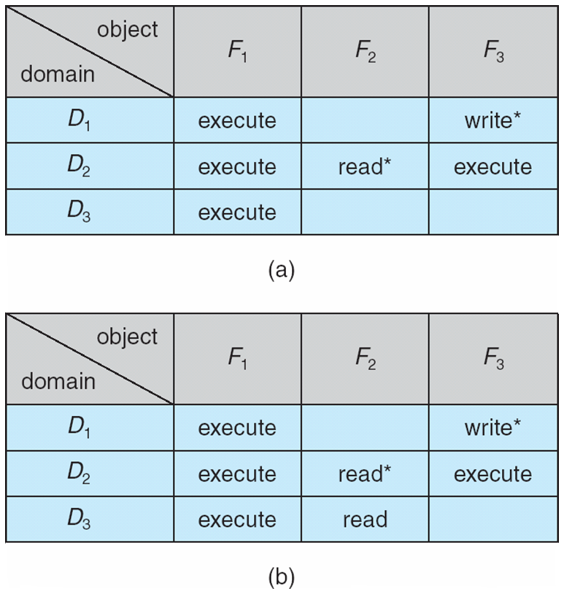
Access Matrix with Copy Rights

Slide 12
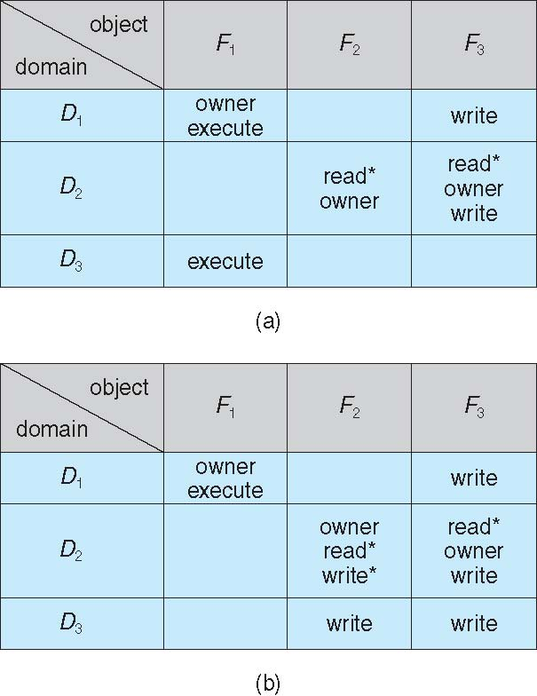
Access Matrix With Owner Rights

Slide 13
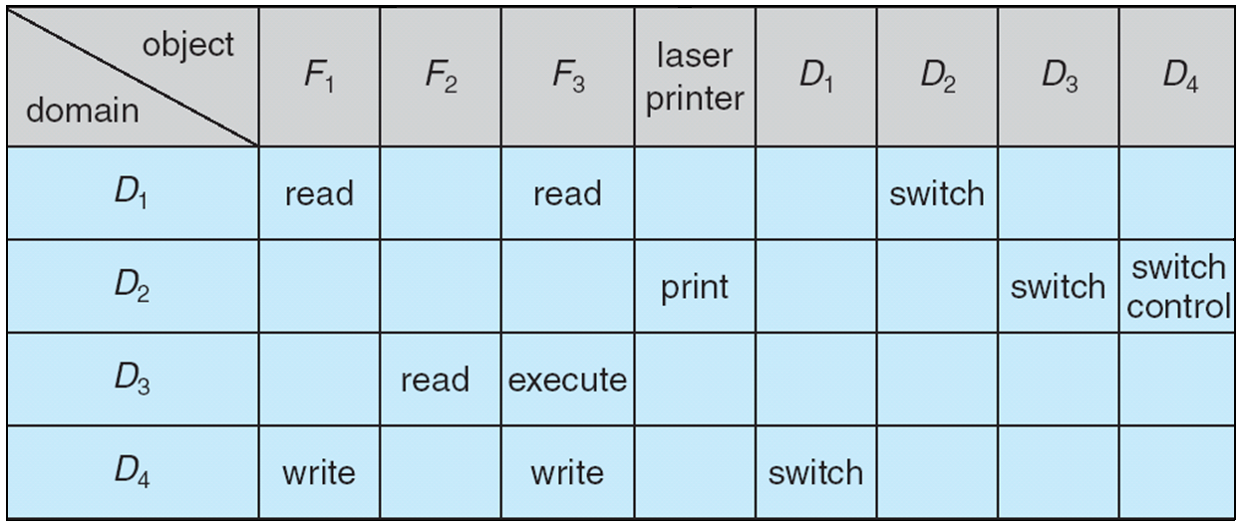
Modified Access Matrix

Slide 14
Implementation of Access Matrix
Generally, a sparse matrix
Option 1 – Global table
Store ordered triples < domain, object, rights-set > in table
A requested operation M on object O_{j} within domain D_{i} -> search table for < D_{i}, O_{j}, R_{k} >
with M ∈ R_{k}
But table could be large -> won’t fit in main memory
Difficult to group objects (consider an object that all domains can read)
Option 2 – Access lists for objects
Each column implemented as an access list for one object
Resulting per-object list consists of ordered pairs < domain, rights-set > defining all domains with non-empty set of access rights for the object
Easily extended to contain default set -> If M ∈ default set, also allow access

Slide 15
Implementation of Access Matrix (Cont.)
Each column = Access-control list for one object Defines who can perform what operation Domain 1 = Read, Write Domain 2 = Read Domain 3 = Read
Each Row = Capability List (like a key) For each domain, what operations allowed on what objects
Object F1 – Read
Object F4 – Read, Write, Execute
Object F5 – Read, Write, Delete, Copy

Slide 16
Implementation of Access Matrix (Cont.)
Option 3 – Capability list for domains
Instead of object-based, list is domain based
Capability list for domain is list of objects together with operations allows on them
Object represented by its name or address, called a capability
Execute operation M on object O_{j}, process requests operation and specifies capability as parameter
Possession of capability means access is allowed
Capability list associated with domain but never directly accessible by domain
Rather, protected object, maintained by OS and accessed indirectly
Like a “secure pointer”
Idea can be extended up to applications
Option 4 – Lock-key
Compromise between access lists and capability lists
Each object has list of unique bit patterns, called locks
Each domain as list of unique bit patterns called keys
Process in a domain can only access object if domain has key that matches one of the locks

Slide 17
Video Links
https://www.youtube.com/watch?v=gr29JiWlTH8 https://www.youtube.com/watch?v=2YIhzk7tJI8

Slide 18
References
https://www.unf.edu/public/cop4610/ree/Notes/PPT/PPT8E/CH15-OS8e.pdf
https://www.tutorialspoint.com/operating_system/os_security.htm
https://www.coursehero.com/file/19323929/Operating-System-Threats-and-Vulnerabilities/
https://www.cs.uic.edu/~jbell/CourseNotes/OperatingSystems/15_Security.html
https://devqa.io/security-threats-attack-vectors/
https://www.geeksforgeeks.org/system-security/
https://www.javatpoint.com/os-security-management

